Slide 1
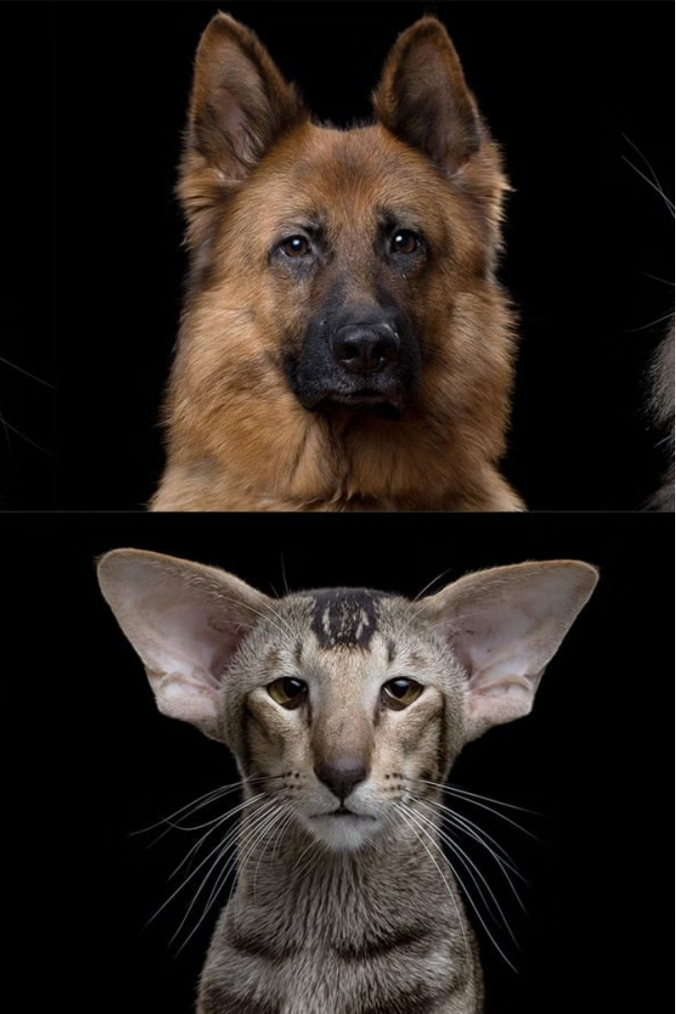
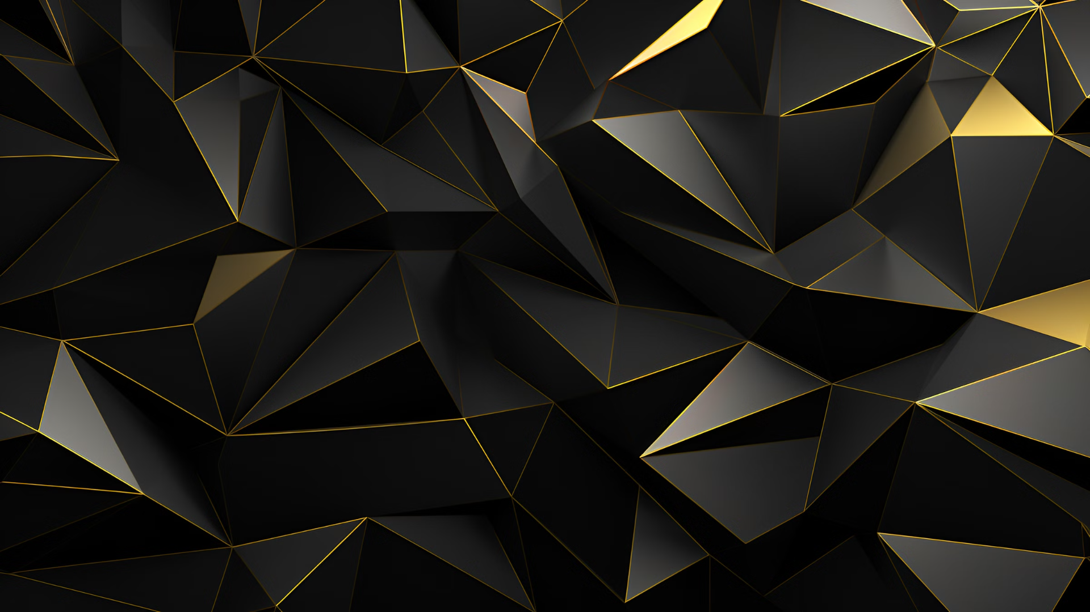

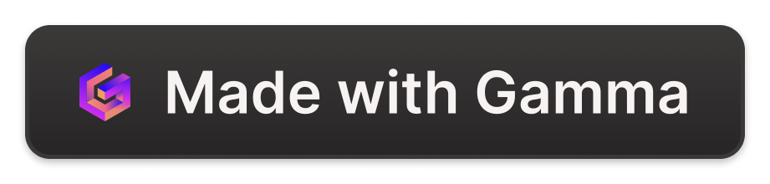
Introduction to Image Segmentation and Breed Classification
This presentation explores the exciting field of image segmentation and breed classification using the Oxford IIIT dataset. We will dive into the methodology, discuss the model architecture, and analyze the evaluation metrics and results. By the end, you'll have a comprehensive understanding of this state-of-the-art computer vision project.
by vasanth gopal

Slide 2
Overview of the Oxford IIIT Dataset
Dataset Details
Image Diversity
Annotation Quality
The Oxford IIIT dataset contains over 37,000 images of 200 dog breeds. It's a widely used benchmark for breed classification tasks in computer vision.
The dataset includes images of dogs in various poses, lighting conditions, and backgrounds, making it a challenging and realistic dataset for model training.
Each image is carefully annotated with bounding boxes and breed labels, providing high-quality ground truth data for supervised learning.

Slide 3
Problem Statement and Objectives
1
Image Segmentation
2
Breed Classification
3
Real-World Applications
Accurately identify and segment the dog within each image, separating the dog from the background.
Classify the dog breed with high accuracy, leveraging the rich visual features in the dataset.
Develop a robust system that can be deployed in practical applications like pet identification and retrieval.

Slide 4
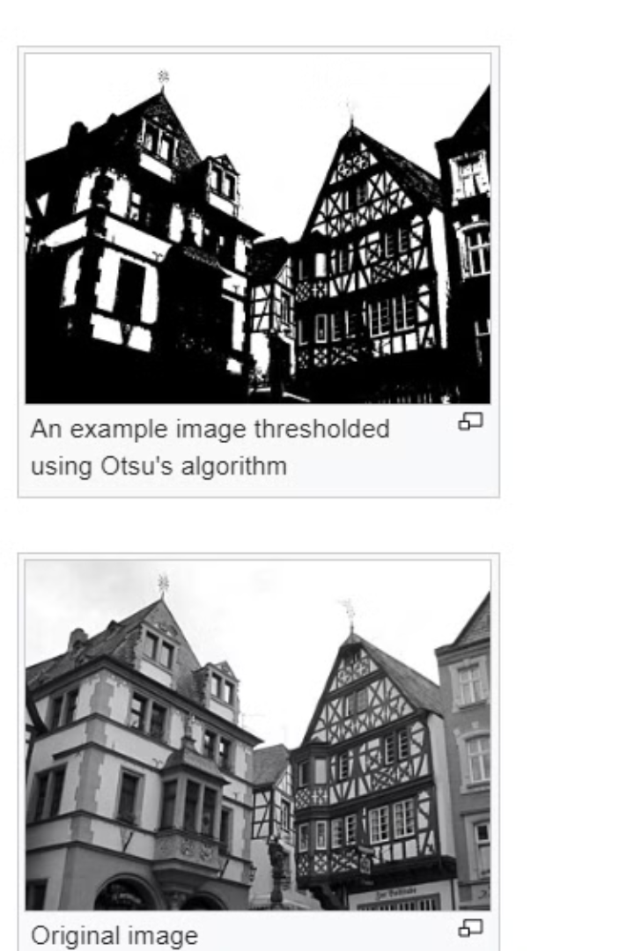
Otsu algorithm and Sobel Operator
Otsu's Method helps in segmenting objects from the background by determining an optimal threshold value for binarization.
Sobel Operator helps in segmenting objects by detecting edges, which are often used as features for segmentation algorithms.
Notes:
Otsu's method and the Sobel operator are both widely used techniques in image processing, albeit for different purposes within the realm of image segmentation. Otsu's Method: This is a popular technique for automatic image thresholding. The goal of thresholding is to separate objects from the background in an image by converting it into a binary image. Otsu's method automatically finds the optimal threshold value by minimizing the intra-class variance of the black and white pixels in the image. Essentially, it determines the threshold that maximizes the inter-class variance between object and background pixels, making it an effective tool for segmenting objects from the background. Sobel Operator: The Sobel operator is a widely used edge detection algorithm. It works by convolving the image with a pair of 3x3 kernels to calculate the gradient approximation of the image intensity function. These kernels highlight regions of high spatial intensity variation, which typically correspond to edges in the image. By identifying these edges, the Sobel operator helps in segmenting objects from the background or from each other.

Slide 5
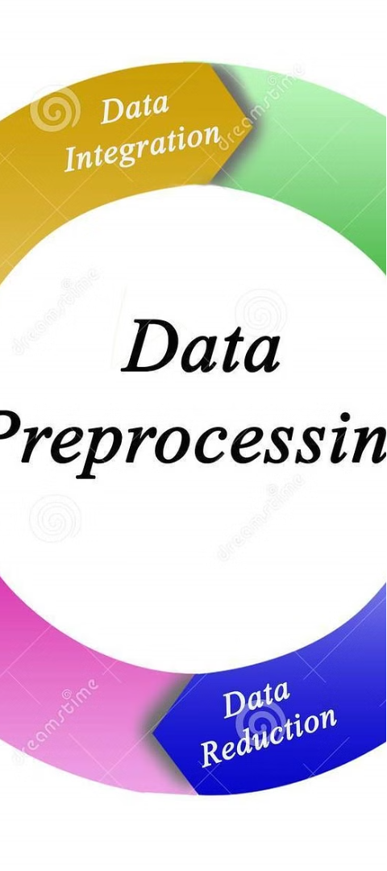
Methodology: Data Preprocessing and Augmentation
1
Data Preprocessing
Resize and normalize the images to a consistent format, handle missing or corrupted data, and encode the breed labels.
2
Data Augmentation
Apply techniques like rotation, flipping, scaling, and color jittering to increase the diversity of the training data and improve model generalization.
3
Train-Test Split
Divide the dataset into training, validation, and test sets to properly evaluate the model's performance and prevent overfitting.

Slide 6
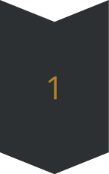
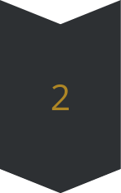
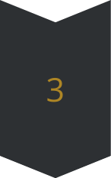
Model Architecture and Training
Feature Extraction
Utilize a pre-trained convolutional neural network (CNN) to extract robust visual features from the input images.
Breed Classification
Feed the extracted features into a fully connected network to classify the dog breed with high accuracy.
Segmentation Mask
Employ a separate segmentation network to generate a pixel-wise mask of the dog within the image.

Slide 7
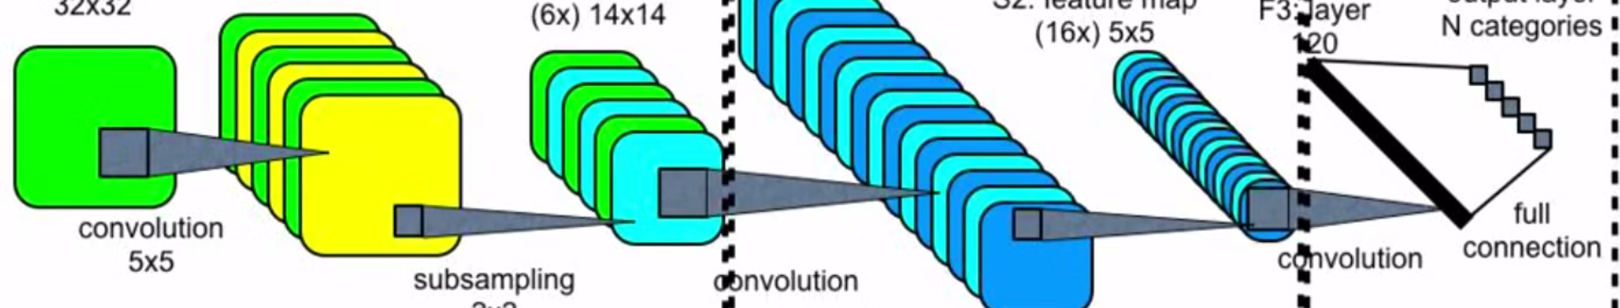
Convolution Neural Networks
Convolutional Neural Networks (CNNs) are a specialized type of neural network designed specifically for processing structured grid data, such as images. They are highly effective for tasks like image recognition, object detection, and image classification. CNNs are inspired by the organization of the animal visual cortex, where individual neurons respond to specific stimuli in a restricted region of the visual field.
Notes:
Components and concepts in CNNs: Convolutional Layers: The fundamental building blocks of CNNs are convolutional layers. Each convolutional layer consists of a set of learnable filters (also known as kernels or convolutional kernels). These filters slide or convolve across the input image, performing element-wise multiplication with the pixel values in the region they cover and then summing up the results to produce a feature map. This process captures spatial hierarchies of patterns in the input image. Pooling Layers: Pooling layers are used to downsample the feature maps generated by convolutional layers. The most common pooling operation is max-pooling, which selects the maximum value from a region of the feature map. Pooling helps in reducing the spatial dimensions of the feature maps, making the network more computationally efficient and reducing overfitting by extracting the most salient features. Activation Functions: Activation functions, such as ReLU (Rectified Linear Unit), are applied after convolutional and pooling operations to introduce non-linearity into the network. This allows the CNN to learn complex patterns and relationships in the data. Fully Connected Layers: Towards the end of the CNN architecture, one or more fully connected layers are typically used to perform classification or regression tasks. These layers connect every neuron in one layer to every neuron in the next layer, allowing the network to learn high-level representations of the input data. Convolutional Neural Network Architecture: CNN architectures vary depending on the specific task and dataset. Common architectures include LeNet, AlexNet, VGGNet, GoogLeNet (Inception), ResNet, and more. These architectures differ in terms of the number of layers, types of layers, and the arrangement of those layers. Training: CNNs are trained using backpropagation and optimization algorithms like stochastic gradient descent (SGD) or its variants. During training, the network learns to adjust the weights of its filters and fully connected layers to minimize a predefined loss function, typically categorical cross-entropy for classification tasks.

Slide 8
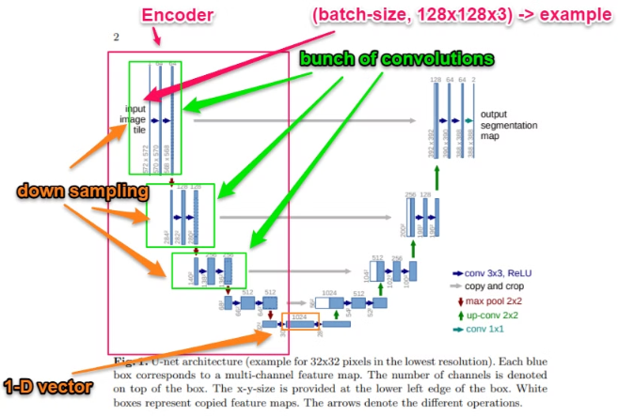
U-net Architecture
U-Net is a popular convolutional neural network architecture designed for semantic segmentation tasks, particularly in medical image analysis, where precise pixel-level segmentation is required. It was introduced by Olaf Ronneberger, Philipp Fischer, and Thomas Brox in their 2015 paper titled "U-Net: Convolutional Networks for Biomedical Image Segmentation."
Notes:
U-Net is a popular convolutional neural network architecture designed for semantic segmentation tasks, particularly in medical image analysis, where precise pixel-level segmentation is required. It was introduced by Olaf Ronneberger, Philipp Fischer, and Thomas Brox in their 2015 paper titled "U-Net: Convolutional Networks for Biomedical Image Segmentation." The U-Net architecture is characterized by its symmetric encoder-decoder structure, which enables the network to capture both local and global features while preserving spatial information. Here's an overview of its key components: Encoder Path: The encoder path is composed of multiple convolutional blocks followed by max-pooling layers. These convolutional blocks perform feature extraction, gradually reducing the spatial dimensions of the input image while increasing the number of feature channels. Each convolutional block typically consists of convolutional layers, activation functions (such as ReLU), and optionally batch normalization to stabilize training. Decoder Path: The decoder path mirrors the encoder path but in reverse. It consists of up-sampling layers (often transposed convolutions or bilinear upsampling) followed by concatenation with feature maps from the corresponding encoder path. These concatenated feature maps are then passed through convolutional blocks, which gradually increase the spatial dimensions while decreasing the number of feature channels. The goal of the decoder path is to recover the spatial details lost during the encoding stage. Skip Connections: One of the key innovations of U-Net is the extensive use of skip connections between the encoder and decoder paths. These skip connections directly connect feature maps from the encoder to the corresponding decoder layers at the same spatial resolution. By providing high-resolution feature maps from earlier layers to later layers, skip connections help the network preserve fine-grained details and improve segmentation accuracy. Final Layer: The final layer of the U-Net architecture typically consists of a 1x1 convolutional layer followed by a softmax activation function. This layer generates the segmentation mask by predicting the probability of each pixel belonging to the target classes. The output mask has the same spatial dimensions as the input image, with each pixel assigned a class label or probability score. Loss Function: U-Net is trained using a pixel-wise loss function, such as cross-entropy loss or Dice loss, which measures the discrepancy between the predicted segmentation mask and the ground truth mask. The network parameters are optimized using gradient descent-based algorithms, such as Adam or stochastic gradient descent (SGD).

Slide 9
MobileNetV2 and Pix2Pix
MobileNetV2 is a convolutional neural network architecture designed for efficient and lightweight deep learning models, particularly targeted for mobile and embedded devices. It is an evolution of the original MobileNet architecture, incorporating improvements to both the architecture and training methodology.
Pix2Pix is a type of conditional generative adversarial network (GAN) designed for image-to-image translation tasks. It was introduced by researchers at the University of California, Berkeley, in 2017. Pix2Pix is particularly powerful for tasks where an input image is transformed into an output image while preserving the semantic content of the input.
Using TensorFlow / Keras
MobileNetV2
Encoder
Pix2Pix
Decoder
Model Compilation
Loss Function
SparseCategoricalCrossEntropy
Notes:
Certainly! MobileNetV2 is a neural network architecture designed for lightweight and efficient deep learning models, especially for mobile and embedded devices. Here's a summarized breakdown of its key features: Depthwise Separable Convolution: MobileNetV2 uses depthwise separable convolutions, which split the convolution operation into depthwise and pointwise convolutions. This reduces parameters and computations, making the model more efficient. Inverted Residuals with Linear Bottlenecks: It introduces inverted residuals with linear bottlenecks, inspired by traditional residual connections but adapted for mobile architectures. Linear bottlenecks help maintain representational power while keeping the model lightweight. Linear Bottleneck: Each inverted residual block includes a linear bottleneck layer to compress and efficiently represent features, reducing computational cost. Expansion Layer: Before applying depthwise convolution, an expansion layer increases the number of channels to capture more complex patterns in the input features. Global Average Pooling and Classification: MobileNetV2 typically ends with global average pooling followed by a fully connected layer for classification. Global average pooling reduces spatial dimensions, providing a compact feature representation for classification. Here's how Pix2Pix works: GAN Architecture: Pix2Pix employs a GAN architecture, which consists of two main components: a generator and a discriminator. Generator: The generator takes an input image and tries to transform it into the desired output image. It learns to do this by generating images that are similar to the target domain while minimizing the difference between the generated images and the ground truth images. Discriminator: The discriminator acts as a critic and tries to distinguish between real images from the target domain and fake images generated by the generator. It provides feedback to the generator, helping it to improve its image generation capabilities over time. Conditional GAN: Pix2Pix is a conditional GAN, which means that both the generator and the discriminator are conditioned on the input image. This conditioning allows the model to learn a mapping from the input domain to the output domain, ensuring that the generated images are semantically consistent with the input images. Image-to-Image Translation: Pix2Pix is specifically designed for image-to-image translation tasks, where the goal is to learn a mapping between two image domains. For example, it can be used for tasks such as: Turning sketches into realistic images. Colorizing black and white images. Converting satellite images to maps. Transforming daytime scenes into nighttime scenes, and vice versa. Loss Functions: Pix2Pix uses a combination of loss functions to train the generator and discriminator. The primary loss function used is the adversarial loss, which encourages the generator to produce realistic images that can fool the discriminator. Additionally, Pix2Pix typically uses L1 or L2 loss to enforce pixel-wise similarity between the generated images and the ground truth images. Overall, Pix2Pix has demonstrated impressive results in various image-to-image translation tasks, producing high-quality and realistic output images. It has found applications in computer vision, graphics, and image editing, among others.

Slide 10



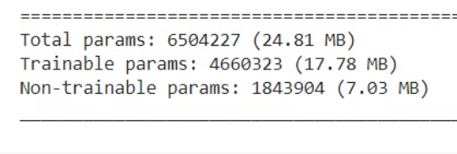
Evaluation Metrics and Results
Total Parameters
Segmentation
Epochs - 10
The image segmentation model was able effectively predict the segmentation mask separating the dog from the background
The model demonstrated high precision, correctly identifying 90.96% of the true dog breed instances.
.

Slide 11
Challenges and Limitations
Occlusion and Clutter
Breed Similarity
Handling images with partial dog visibility or complex backgrounds remains a challenge for the segmentation model.
Distinguishing between visually similar dog breeds can be difficult, requiring more advanced feature representations.
Dataset Bias
Real-Time Deployment
The dataset may not fully represent the diversity of dog breeds, leading to biases in the model's performance.
Deploying the model in real-world applications with strict latency requirements is an ongoing engineering challenge.

Slide 12
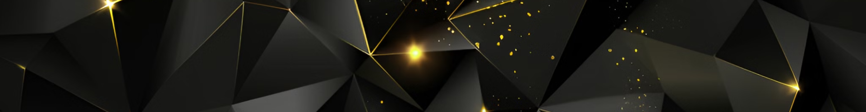
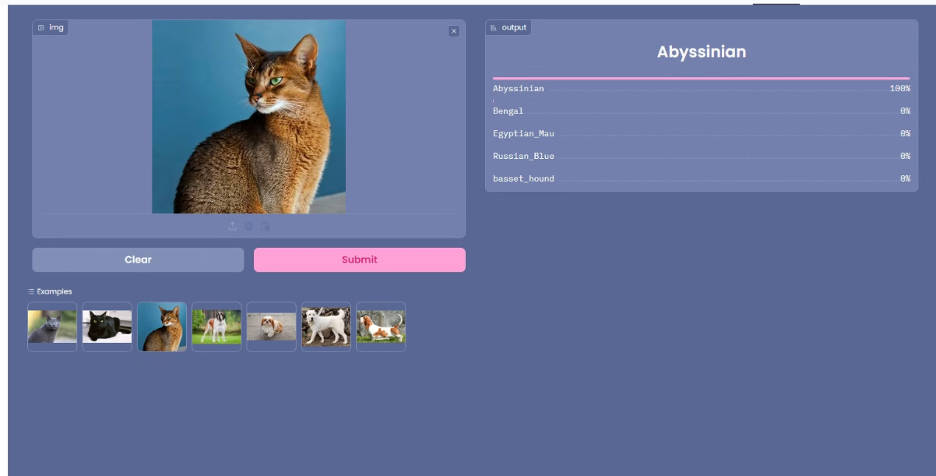
Model Deployment with Gradio and Huggingface / Spaces

Slide 13
Conclusion and Future Work
Key Takeaways
Future Directions
Real-World Impact
The presented system demonstrates the power of deep learning in tackling complex computer vision tasks, such as image segmentation and breed classification.
Explore more advanced architectures, incorporate additional data sources, and investigate transfer learning to further improve the model's performance and robustness.
The developed technology has the potential to enable a wide range of practical applications, from pet identification to wildlife monitoring and beyond.

